Slide 1
Data Polygamy: The Many-Many Relationships among
Urban Spatio-Temporal Data Sets
Notes:
探究城市空间数据集之间的关系

Slide 2
1. Introduction
2. Challenge
3. Topology-based relationships
3.1 Notion
3.2 Relationship Evaluation
3.3 Data set transformation
3.4 Feature Identification
4. Relationship operator
5. Data Polygamy framework
6.Evaluation

Slide 3
1. Introduction
2. Challenge
3. Topology-based relationships
3.1 Notion
3.2 Relationship Evaluation
3.3 Data set transformation
3.4 Feature Identification
4. Relationship operator
5. Data Polygamy framework
6.Evaluation

Slide 4
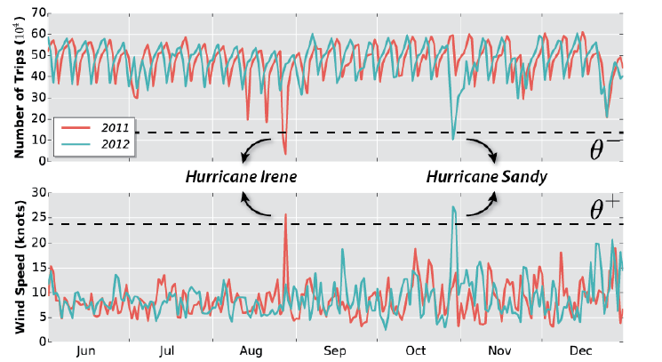
1. Introduction
Notes:
2011 2012年纽约每天出租车的数量，基本保持在一个稳定的状态，40万到60万左右，但是，可以很明显地看到两个很大的低谷，2011年8月和2012年10月
那么，造成这两个低谷的原因？猜想可能是天气
测量整年的风速变化，可以看到在低谷发生的时期风速很大。飓风
因此，提出，风速的变化会影响出租车的数量。也发现了天气和出租车这两个数据集的关系。
特点，只发生在特定的时间地点。

Slide 5
1. Introduction
2. Challenge
3. Topology-based relationships
3.1 Notion
3.2 Relationship Evaluation
3.3 Data set transformation
3.4 Feature Identification
4. Relationship operator
5. Data Polygamy framework
6.Evaluation

Slide 6
2. Challenges
a relationship between two data sets may occur only at certain locations and/or time periods.
the number and size of the data sets is large
these data sets contain both spatial and temporal attributes at different resolutions.
it is hard to identify between meaningful and spurious relationships.
Notes:
只发生在特定的时间地点。

Slide 7
1. Introduction
2. Challenge
3. Topology-based relationships
3.1 Notion
3.2 Relationship Evaluation
3.3 Data set transformation
3.4 Feature Identification
4. Relationship operator
5. Data Polygamy framework
6.Evaluation

Slide 8
1. Introduction
2. Challenge
3. Topology-based relationships
3.1 Notion
3.2 Relationship Evaluation
3.3 Data set transformation
3.4 Feature Identification
4. Relationship operator
5. Data Polygamy framework
6.Evaluation

Slide 9
Notion of topology-based relationships
the salient features of two data sets have relationship
two data sets are related
A salient feature : exhibit an unusual behavior with respect to its neighborhood.
Notes:
两个数据有关系，只有当数据的显著特征有关系时
问题从 找两个数据集有无关系 转成 找数据集显著特征有无关系

Slide 10
1. Introduction
2. Challenge
3. Topology-based relationships
3.1 Notion
3.2 Relationship Evaluation
3.3 Data set transformation
3.4 Feature Identification
4. Relationship operator
5. Data Polygamy framework
6.Evaluation

Slide 11
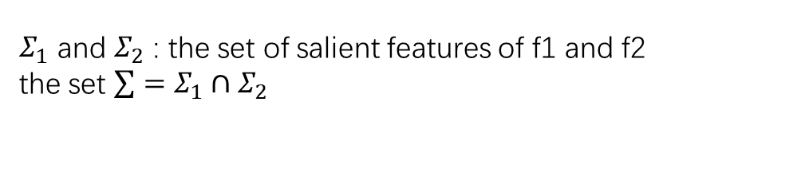
Feature Relatedness
assume two data sets D1,D2
f1(D1,A1) corresponding to attribute A1 of D1
f2(D2,B1) corresponding to attribute B1 of D2.
$Σ_{1}$ and $Σ_{2}$ : the set of salient features of f1 and f2
the set $\sum{=Σ_{1}∩Σ_{2}}$
f1 and f2 are feature-related at a spatio-temporal point $x=(s,t)$ if $x ε Σ$
positively related at a spatio-temporal point $xεΣ$ if ($x ε{ Σ}_{1}^{+}$ and $x ε Σ_{2}^{+}$) or ($x ε{ Σ}_{1}^{−}$ and $x ε{ Σ}_{2}^{−}$).
negatively related at a spatio-temporal point $xεΣ$ if ($x ε{ Σ}_{1}^{+} \text{and} x ε{ Σ}_{2}^{−}$) or ($x ε Σ_{1}^{−} \text{and} x ε{ Σ}_{2}^{+}$).

Slide 12

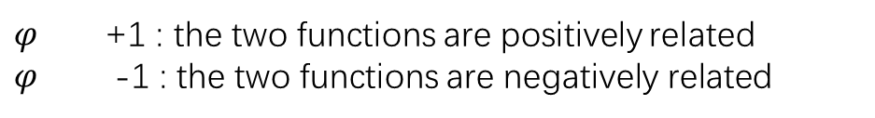
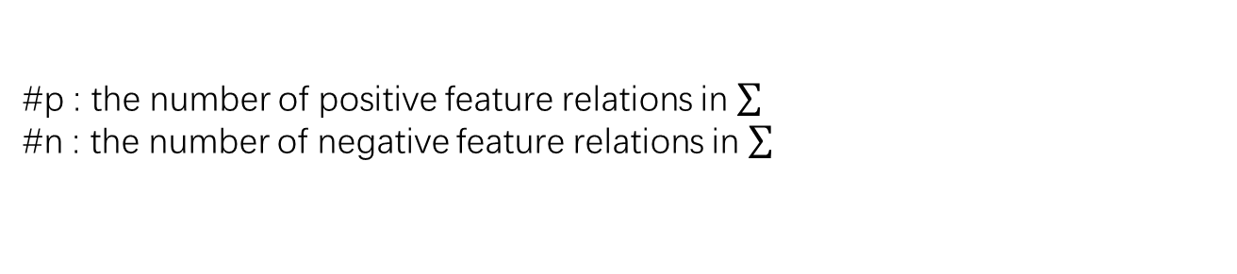

Function Relationship
Relationship Score $φ$
$$φ=\frac{\#p−\#n}{|\sum{|}}$$
#p : the number of positive feature relations in
#n : the number of negative feature relations in
$φ$ +1 : the two functions are positively related
$φ$ -1 : the two functions are negatively related
Notes:
衡量关系的紧密程度？

Slide 13

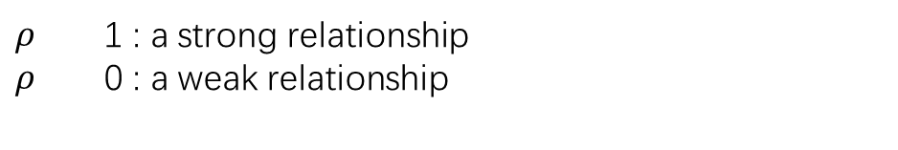

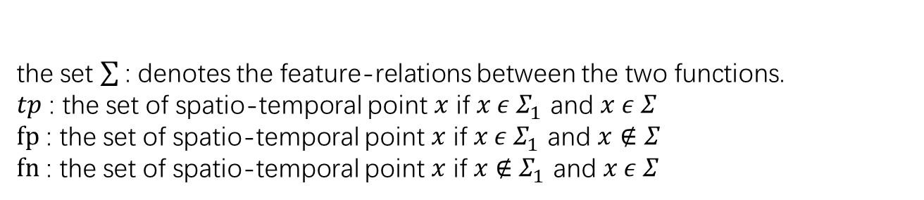



Relationship Evaluation
Relationship Strength $ρ$
$$ρ=F_{1}(f_{1},f_{2})=2×\frac{precision×recall}{precision+recall}$$
$$precision=\frac{\#tp}{\#tp+\#fp}$$
$$recall=\frac{\#tp}{\#tp+\#fn}$$
the set : denotes the feature-relations between the two functions.
$tp$ : the set of spatio-temporal point $x$ if $x ε{ Σ}_{1}^{ }$ and $x ε Σ_{ }^{ }$
$fp$ : the set of spatio-temporal point $x$ if $x ε{ Σ}_{1}^{ }$ and $x∉Σ_{ }^{ }$
$fn$ : the set of spatio-temporal point $x$ if $x∉{ Σ}_{1}^{ }$ and $x ε Σ_{ }^{ }$
$ρ$ 1 : a strong relationship
$ρ$ 0 : a weak relationship
precision gives a measure of how often features in f1 are related with features in f2
recall gives a measure of how often features in f2 are related with features in f1
Notes:
调和平均值

Slide 14
1. Introduction
2. Challenge
3. Topology-based relationships
3.1 Notion
3.2 Relationship Evaluation
3.3 Data set transformation
3.4 Feature Identification
4. Relationship operator
5. Data Polygamy framework
6.Evaluation

Slide 15
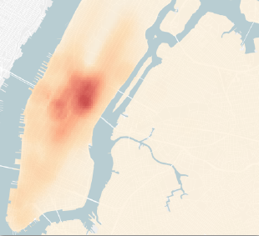
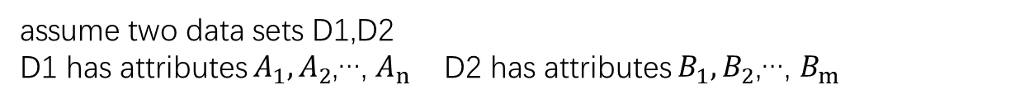
Data set transformation
assume two data sets D1,D2
D1 has attributes $A_{1},A_{2}$,…, $A_{n}$ D2 has attributes $B_{1},B_{2}$,…, $B_{m}$
Each attribute of the two data sets is transformed into a scalar function.
scalar function f1(D1,A1) indicates attribute A1 value changes.
assume the scalar function f is a Morse function
property (i) no two critical points have the same function value
(ii) there are no degenerate critical points
Notes:
二阶导数not = 0
一阶导数为常数
函数为直线

Slide 16
1. Introduction
2. Challenge
3. Topology-based relationships
3.1 Notion
3.2 Relationship Evaluation
3.3 Data set transformation
3.4 Feature Identification
4. Relationship operator
5. Data Polygamy framework
6.Evaluation

Slide 17
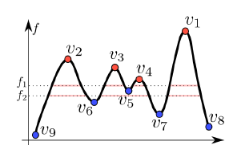
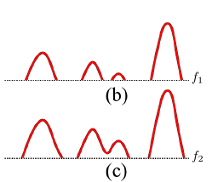


Topological Features
critical points(extreme points) : points of function f where gradient =0
maxima : critical points than greater than its neighborhood v1 v2 v3 v4
minima : critical points than less than its neighborhood v5 v6 v7 v8 v9
topological features : the neighborhood of critical points
super-level set : the neighborhoods of the maxima
if given a real value $θ$: the set of all points on the domain of f
having function value greater than or equal to $θ$
sub-level set : the neighborhoods of the minima
if given a real value $θ$: the set of all points on the domain of f
having function value less than or equal to $θ$
(b) The super-level set at f1 consists of four components.
(c) The super-level set at f2 consists of three components.

Slide 18
Salient Features
positive features :defined as super-level sets , if given a feature threshold $θ^{+}$
negative features : defined as sub-level sets , if given a feature threshold $θ^{−}$
the thresholds $θ^{+}$ and $θ^{−}$ define the extent of normal behavior of $A_{i}$.
Salient features : identified by appropriately setting the values of these thresholds $θ^{+}$ and $θ^{−}$
How to efficiently identify salient features corresponding to a scalar function ?
Merge tree
Notes:
特征阈值
Ai 数据集属性

Slide 19
Merge tree index---index creation
A merge tree tracks the evolution of super-level sets or sub-level sets of f with changing function value.
The join tree of f tracks the connected components of the super-level sets of f with decreasing function value.
The split tree of f tracks the connected components of the sub-level sets of f with increasing function value.
Notes:
Merge tree跟踪了 随着函数值的变化，f的super-level sets或sub-level sets的变化
从函数最大值逐渐减小，对应super-level sets部件的变化成为 join tree
从函数最小值逐渐增大，对应sub-level sets部件的变化成为 split tree

Slide 20

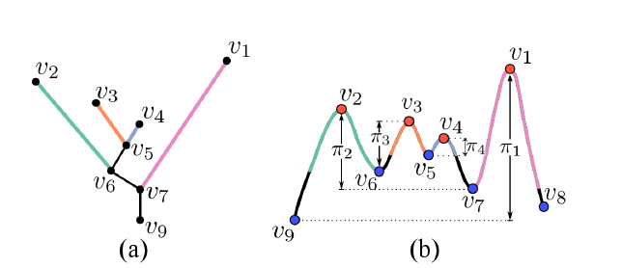













Merge tree index---index creation
$$f_{0}$$
$$f_{0}$$
$$f_{1}$$
$$f_{1}$$
$$f_{3}$$
$$f_{2}$$
$$f_{4}$$
$$f_{2}$$
$$f_{3}$$
join tree
$$f_{4}$$
the nodes correspond to critical points where the number of components change,
an edge represents the connected super-level set component between its end points.

Slide 21
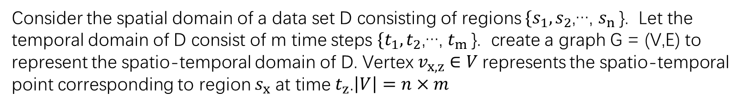
Merge tree index---index creation
Consider the spatial domain of a data set D consisting of regions $\{s_{1},s_{2}$,…, $s_{n}$}. Let the temporal domain of D consist of m time steps $\{t_{1},t_{2}$,…, $t_{m}$}. create a graph G = (V,E) to represent the spatio-temporal domain of D. Vertex $v_{x,z}∈V$represents the spatio-temporal point corresponding to region $s_{x}$ at time $t_{z}$.$\left|V\right|=n×m$

Slide 22
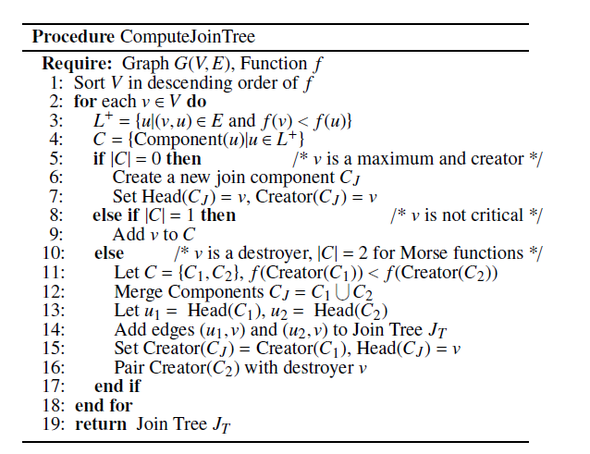
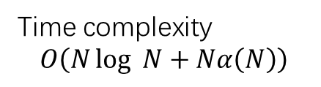
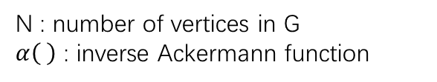

Merge tree index---index creation
$$>$$
Time complexity
$$O\left(N\log_{ }{N+Nα\left(N\right)}\right)$$
N : number of vertices in G
$α\left( \right)$ : inverse Ackermann function

Slide 23
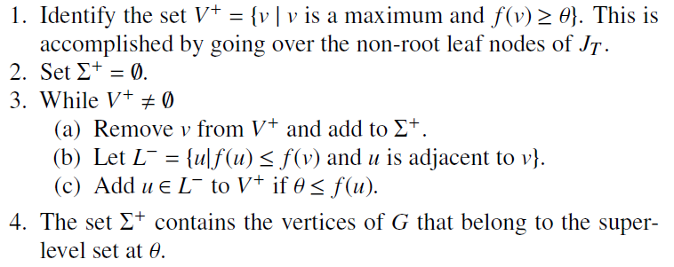

Merge tree index---query feature
Example: compute the super-level set using the join tree
Time complexity
$O\left(Σ^{+}\right)$ or $O\left(Σ^{−}\right)$

Slide 24
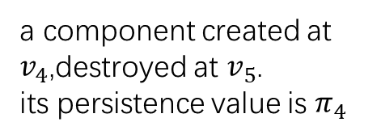
Merge tree index---salient feature threshold computation
Topological persistence
one component can occur at a creator $c_{i}$ and destroy at a destroyer $d_{i}$
pair up uniquely ($c_{i}$, $d_{i}$)
the persistence value of $c_{i}$ and $d_{i}$ =$|f\left(d_{i}\right)−f\left(c_{i}\right)|$ , indicates the lifetime of the feature created at $c_{i}$.
a component created at $v_{4}$,destroyed at $v_{5}$.
its persistence value is $π_{4}$

Slide 25
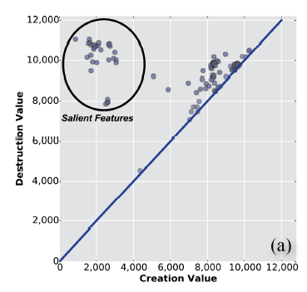
Merge tree index--- salient feature threshold computation
persistence diagram plots the maxima (or minima) of the input function as a set of points on a 2D plane, where the x and y coordinates of a feature correspond to its creation and destruction value.
persistence diagram of minima
Our goal is to select a threshold $θ^{−}$such that all the high persistence minima are identified as salient features.
To do this automatically, perform k-means clustering with k = 2 and use the highest value over all minima in the high persistence cluster as the threshold $θ^{−}$.
Notes:
用存在时间长的那类 中的 最大的值 作为 $θ^{−}$

Slide 26
1. Introduction
2. Challenge
3. Topology-based relationships
3.1 Notion
3.2 Relationship Evaluation
3.3 Data set transformation
3.4 Feature Identification
4. Relationship operator
5. Data Polygamy framework
6.Evaluation

Slide 27
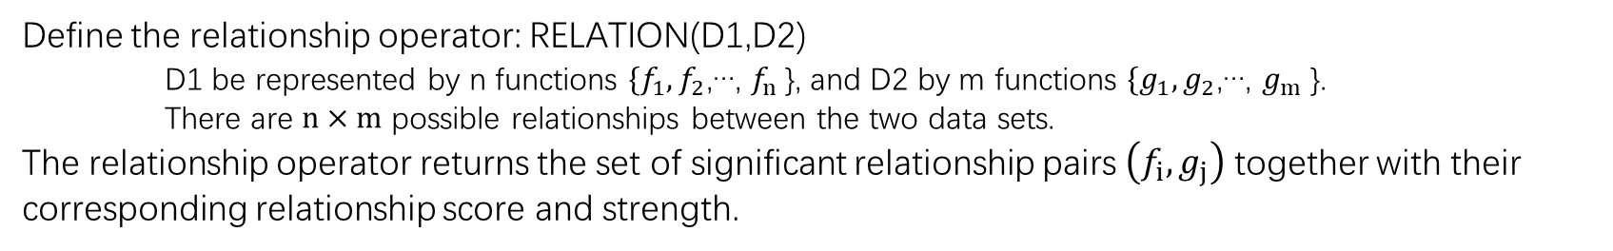
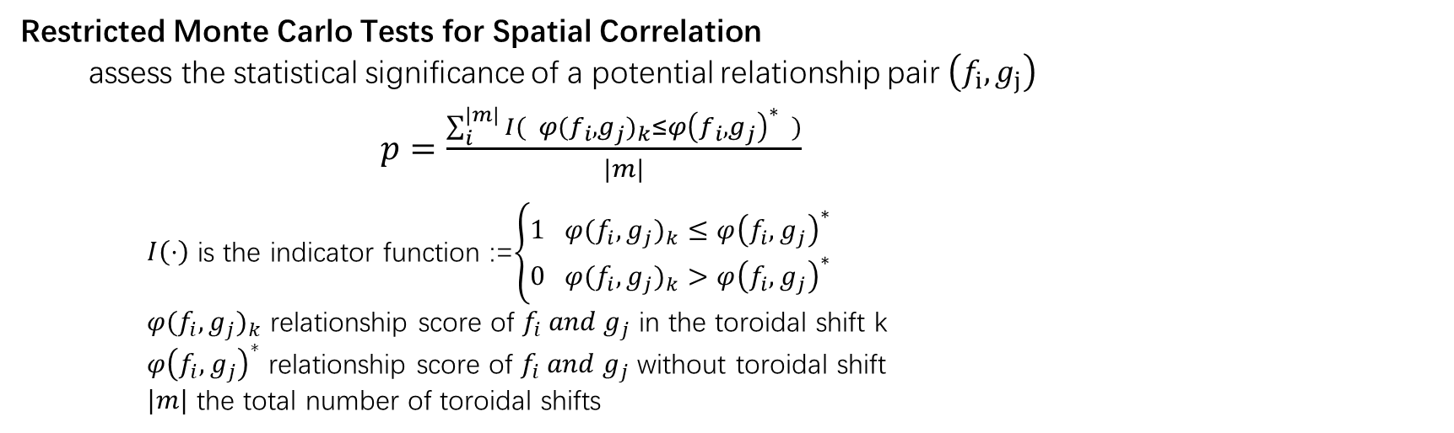
Relationship operator
Define the relationship operator: RELATION(D1,D2)
D1 be represented by n functions $\{f_{1},f_{2}$,…, $f_{n}$}, and D2 by m functions $\{g_{1},g_{2}$,…, $g_{m}$}.
There are $n×m$ possible relationships between the two data sets.
The relationship operator returns the set of significant relationship pairs $\left(f_{i},g_{j}\right)$ together with their corresponding relationship score and strength.
Restricted Monte Carlo Tests for Spatial Correlation
assess the statistical significance of a potential relationship pair $\left(f_{i},g_{j}\right)$
$p=\frac{\sum_{i}^{|m|}{{I( φ(f_{i},g_{j})}_{k}≤{φ\left(f_{i},g_{j}\right)}^{∗} )}}{|m|}$
$I\left(⋅\right)$ is the indicator function :=$\left\{\begin{aligned}1 {φ(f_{i},g_{j})}_{k}≤{φ\left(f_{i},g_{j}\right)}^{∗} \\ 0{ φ(f_{i},g_{j})}_{k}>{φ\left(f_{i},g_{j}\right)}^{∗}\end{aligned}\right.$
${φ(f_{i},g_{j})}_{k}$ relationship score of $f_{i}{ and g}_{j}$ in the toroidal shift k
${φ\left(f_{i},g_{j}\right)}^{∗}$ relationship score of $f_{i}{ and g}_{j}$ without toroidal shift
$|m|$ the total number of toroidal shifts
The relationship between two functions $f_{i}$ and $g_{i}$ is statistically significant if $p≤α$
$α$ is a significance level , and set at commonly used valued of 5%.
Notes:
关系操作符：返回数据集中 关系有意义的属性对
前面介绍了两个数据集 在属性A1,B1上可能有的关系
判断这个关系的意义，也是challenges 3
设计了限制蒙特卡洛空间相关性测试 ，通过设计环形移位实现
假设 区域在 函数顶部和底部边缘处以及在其左侧和右侧处连接。对点进行随机移位，并返回所得的一组点。
I 指标函数

Slide 28
1. Introduction
2. Challenge
3. Topology-based relationships
3.1 Notion
3.2 Data set transformation
3.3 Feature Identification
3.4 Relationship Evaluation
4. Relationship operator
5. Data Polygamy framework
6.Evaluation

Slide 29
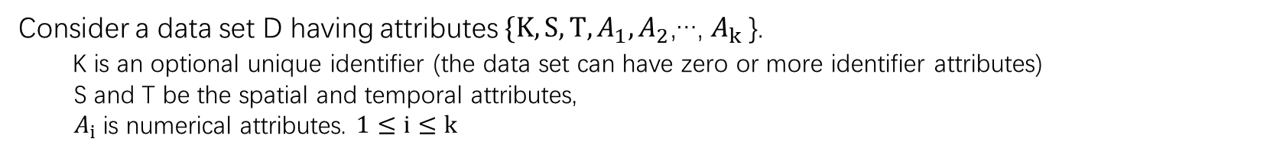
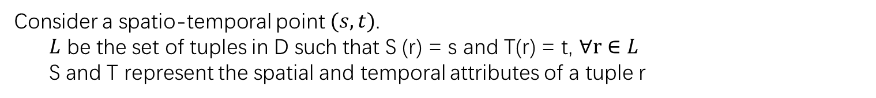
Types of scalar function
Consider a data set D having attributes $\{K,S,T,A_{1},A_{2}$,…, $A_{k}$}.
K is an optional unique identifier (the data set can have zero or more identifier attributes)
S and T be the spatial and temporal attributes,
$A_{i}$is numerical attributes. $1≤ⅈ≤k$
Count functions : capture the activity of the entity represented by the data set.
Consider a spatio-temporal point $(s,t)$.
$L$ be the set of tuples in D such that S (r) = s and T(r) = t, $∀r∈L$
S and T represent the spatial and temporal attributes of a tuple r
density function assigns the value $|L|$ to the spatio-temporal point (s, t).
Unique function assigns a value equal to the number of unique identifiers of $L$
to the spatio-temporal point.
Attribute functions : represent the variation of a given attribute over space and time.
Notes:
标识符属性
捕获由数据集表示的实体的活动，比如 表示 合肥包河区11.23日内出入的出租车的数量，这里面包括了当一个出租车两次进入包河区内时，这个车算一次还是两次？
Density function 表示多次。
Unique function 表示一次。

Slide 30
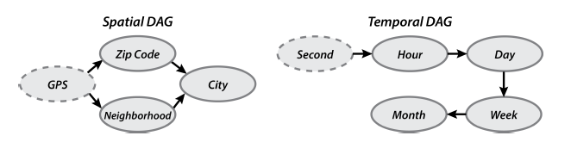
Handling different data resolutions
when considering a pair of functions, the relationship between them is evaluated for all possible resolutions starting with the highest common resolution.
Notes:
区号

Slide 31
1. Introduction
2. Challenge
3. Topology-based relationships
3.1 Notion
3.2 Data set transformation
3.3 Feature Identification
3.4 Relationship Evaluation
4. Relationship operator
5. Data Polygamy framework
6.Evaluation

Slide 32
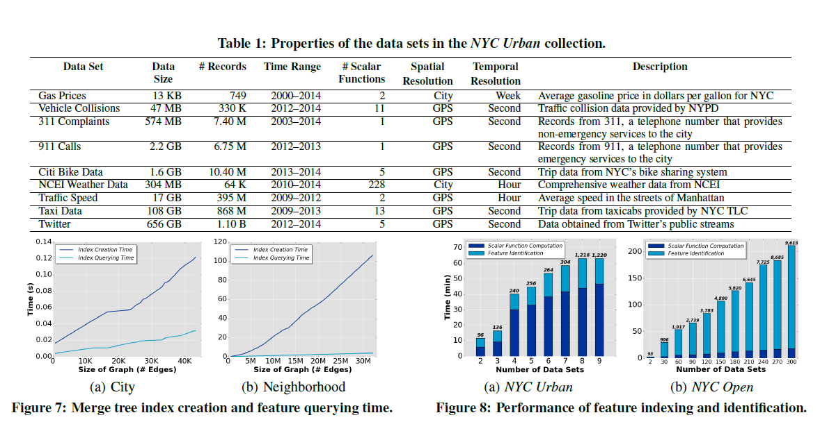
Evaluation

Slide 33
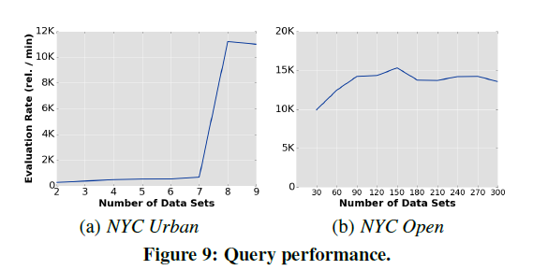
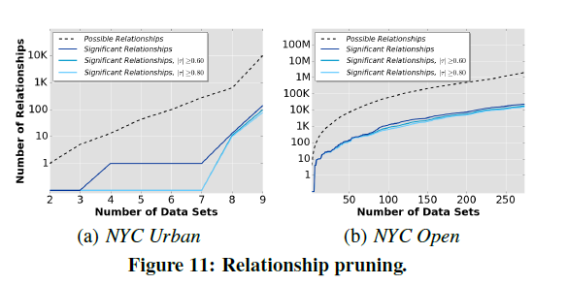
Evaluation

